Slide 1



LSU football: Do home games affect Baton Rouge crime rates?

Slide 2

How it started: Open Data BR
Baton Rouge City-Parish government public data sets
East Baton Rouge Parish Combined Crime Incidents
Combination of crime incident reports from the East Baton Rouge Parish Sheriff's Office and the Baton Rouge Police Department, beginning January 1, 2021. Includes records for all crimes such as burglaries (vehicle, residential and non-residential), robberies (individual and business), auto theft, homicides and other crimes against people, property and society.

Slide 3
Crime Incidents Data
Date & time
Geographic information
Address (some exceptions: sexual assault, domestic violence, human trafficking, and juveniles)
Police district, zone, and subzone
Neighborhood, Council district, crime prevention district
Latitude & longitude
Crime description
Crime against (Person, Property, or Society)
Statute category, title, and description
NIBRS* code and description
~277,000 rows
Each row represents a single charge.
A crime incident can have multiple charges.
*National Incident-Based Reporting System

Slide 4
Sample data
charge_date | street | district | zone | statute_title | statute_description | statute_category | offense_description
10/22/2022 4:56 | 13921 JOOR RD | P | P1 | 26910 | INVESTIGATION | OTHER
10/15/2022 18:53 | 1145 MAVIS DR | B | B1 | 30604 | N.C. NEIGHBOR TROUBLE | OTHER
12/10/2022 19:26 | 5439 AIRLINE HWY | 4 | 4D | 26910 | INVESTIGATION | OTHER
9/4/2021 23:56 | 9316 BURBANK DR | B | B1 | C.CR.P. ART 202 | WARRANT/BENCH WARRANT | OTHER
12/3/2022 13:28 | 15959 TIGER BEND RD | K | K1 | 0.626388889 | SIMPLE BURGLARY | NON-RESIDENTIAL BURGLARY | THEFT FROM MOTOR VEHICLE
11/4/2023 11:44 |  |  |  | 2301 | PRIVATE PROPERTY CRASH | TRAFFIC
10/30/2021 19:37 |  | B | B1 | 14:35.3 | DOMESTIC ABUSE BATTERY | BATTERY | SIMPLE ASSAULT
9/25/2021 20:43 | 2001 S SHERWOOD FOREST BLVD | 3 | 3E | 0.626388889 | SIMPLE BURGLARY | NON-RESIDENTIAL BURGLARY | BURGLARY/BREAKING & ENTERING
10/29/2022 18:17 | 5217 SLEEPY HOLLOW DR | K | K1 | 14:56 | SIMPLE CRIMINAL DAMAGE TO PROPERTY | CRIMINAL DAMAGE TO PROPERTY | DESTRUCTION/DAMAGE/VANDALISM OF PROPERTY
10/21/2023 16:43 | N 22ND ST / MAIN ST | 1 | 1B | 11:45 | TRAFFIC-CONTROL SIGNALS | TRAFFIC
11/18/2023 15:48 | 9830 OLD HAMMOND HWY | 3 | 3C | 14:07.1 | THEFT OF GOODS (SHOPLIFTING) | THEFT | SHOPLIFTING
12/31/2022 14:27 | 820 MEADOW GLEN AVE |  |  | 30610 | N.C. DISTURBANCE | OTHER
11/5/2022 15:00 | 2959 COLLEGE DR | 2 | 2B | 13:103(A)(3) | DISTURBING THE PEACE (INTOXICATION) | OTHER | DRUNKENNESS
12/4/2021 21:00 | 2421 S ACADIAN THWY | 2 | 2B | 0.626388889 | SIMPLE BURGLARY | NON-RESIDENTIAL BURGLARY | BURGLARY/BREAKING & ENTERING
9/17/2022 10:13 | 403 KIMBRO DR | 2 | 2E | 15:02.2 | SIMPLE BURGLARY OF AN INHABITED DWELLING | RESIDENTIAL BURGLARY | BURGLARY/BREAKING & ENTERING

Slide 5

What could have a short-term impact on crime?
A big event…
Weather
Entertainment
Emergency

Slide 6
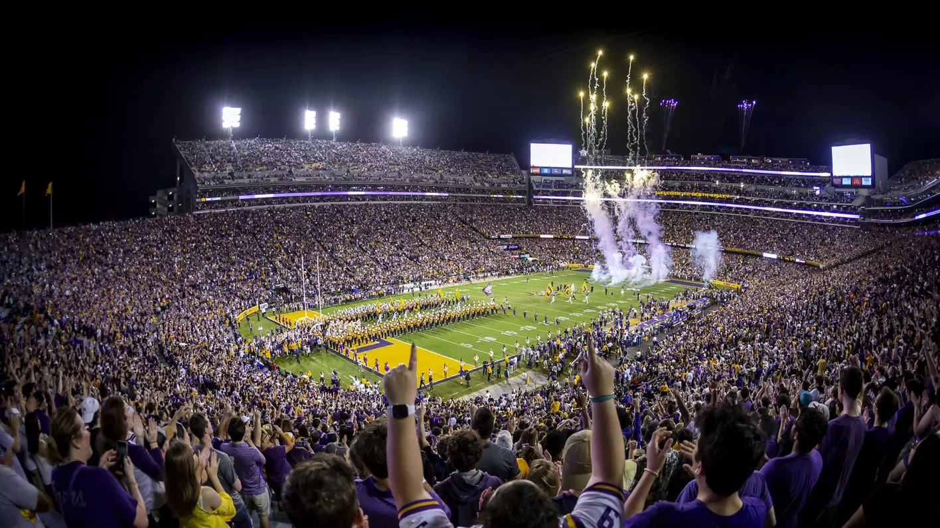
LSU Football!

Slide 7

In Baton Rouge, LSU football games are a big deal
Tiger stadium (a.k.a “Death Valley”) is the 7th largest stadium in the world. It seats over 102,000 people and covers 27 acres.
Football games average 100,000 attendees.
Tailgating around the stadium lasts all day
4 different parking lots are allocated just to RVs
Contraflow traffic after a game can last up to 3 hours

Slide 8
Could the occurrence of an LSU home football game impact the number of crimes that occur that day?

Slide 9
Design
LSU football schedules for 2021-2023 ➧ filter for home games
All home games occurred on Saturdays.
All home games took place during September-December.
Compare to Saturdays in September-December that didn’t have a home football game.

Slide 10
Null hypothesis
Number of crime incidents on Saturdays with LSU home games
No difference
Number of crime incidents on Saturdays where LSU does not play at home.

Slide 11
Alternate hypothesis
Number of crime incidents on Saturdays with LSU home games
Different
Number of crime incidents on Saturdays where LSU does not play at home.

Slide 12
Exploratory Data Analysis

Slide 13
Home game days do have a slightly higher average
home_game | count | mean | std | min | 25% | 50% | 75% | max
FALSE | 35 | 131.09 | 32.91 | 22 | 121 | 143 | 152 | 173
TRUE | 21 | 144.90 | 15.91 | 115 | 132 | 145 | 156 | 172

Slide 14
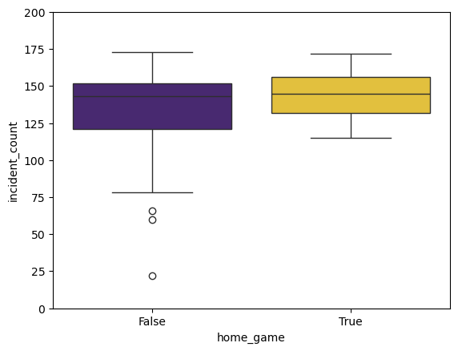
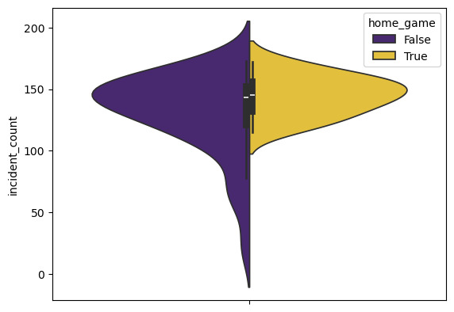
Box plot & violin plot
Days without home games are skewed to the left (more days with low crime).
The home game distribution is symmetrical and tighter.

Slide 15
The t-test

Slide 16
t-test results
α = 0.5
p = 0.778
Since p > α, we cannot reject the null hypothesis.
However at α = 0.10 we could reject the null hypothesis.
p = 0.778 means that if we reject the null hypothesis, there is approximately an 8% chance we have done so erroneously (Type I error).

Slide 17
Further questions
More data would be helpful. There is a separate data set for crimes before 2021.
The datasets are separate because of a BRPD system conversion at the end of 2020 that resulted in a new format, coding, and records management framework for crime incidents.

Slide 18
Further questions
It would be interesting to compare incidences of crime by type (there are 19 different statute categories assigned in the data set).
It would be interesting to compare incidences by location (does proximity to LSU have an effect).
charge_date | 11/5/2022 15:00
attempted_committed | COMMITTED
street | 2959 COLLEGE DR
city | BATON ROUGE
state | LA
postal_code | 70808
district | 2
zone | 2B
sub_zone | 2B2
statute_title | 13:103(A)(3)
statute_description | DISTURBING THE PEACE (INTOXICATION)
statute_category | OTHER
crime_against | SOCIETY
nibrs_code | 90E
offense_description | DRUNKENNESS
council_district | 12
crime_prevention_district
neighborhood | BOCAGE / CITIPLACE / CONCORD ESTATES
longitude | -91.140186
latitude | 30.421275
charge_day | 11/5/2022
home_game | TRUE
game_result | #15 LSU 32, #6 Alabama 31 (OT)

